Slide 1
EE462L, Spring 2014
MOSFET Firing Circuit

Slide 2
Power MOSFETs
(high-speed, voltage-controlled switches that allow us to operate above the 20kHz audible range)
D: Drain
D
If desired, a series blocking diode can be inserted here to prevent reverse current
G: Gate
G
Switch closes when V_{GS} ≈ 4V, and opens when V_{GS}= 0V
S: Source
S
N channel MOSFET equivalent circuit
Controlled turn on, controlled turn off
(but there is an internal antiparallel diode)

Slide 3
We Avoid the Linear (Lossy) Region, Using Only the On and Off States
MOSFET “on”
MOSFET “off”
D
D
S
S
when V_{GS} = 12V
when V_{GS} = 0V

Slide 4
We Want to Switch Quickly to Minimize Switching Losses
Turn Off
Turn On
V_{DS}(t)
V_{DS}(t)
0
0
I(t)
Δt_{off}
I(t)
Δt_{on}
0
0
P_{LOSS}(t)
P_{LOSS}(t)
Energy lost per turn off
Energy lost per turn on
0
0
Turn off and turn on times limit the frequency of operation because their sum must be considerably less than period T (i.e., 1/f)

Slide 5
Consider, for example, the turn off
Turn Off
V_{DS}(t)
Energy lost per turn off is proportional to
V
V • I • Δt_{off} ,
0
so we want to keep turn off (and turn on) times as small as possible.
I(t)
I
The more often we switch, the more “energy loss areas” we experience per second.
0
P_{LOSS}(t)
Δt_{off}
Thus, switching losses (average W) are proportional to switching frequency f, V, I, Δt_{off}, and Δt_{on}.
Energy lost per turn off
0
And, of course, there are conduction losses that are proportional to squared I

Slide 6
Advantages of Operating Above 20kHz
Yes, switching losses in power electronic switches do increase with operating frequency, but going beyond 20kHz has important advantages. Among these are
Humans cannot hear the circuits
For the same desired smoothing effect, L’s and C’s can be smaller because, as frequency increases and period T decreases, L’s and C’s charge and discharge less energy per cycle of operation. Smaller L’s and C’s permit smaller, lighter circuits.
Correspondingly, L and C rms ripple currents decrease, so current ratings can be lower. Thus, smaller, lighter circuits.
AC transformers are smaller because, for a given voltage rating, the peak flux density in the core is reduced (which means transformer cores can have smaller cross sectional areas A).
Thus, smaller, lighter circuits.
N = number of turns, ϕ = magnetic flux, B = magnetic field, A = x-sectional area

Slide 7
Fast Switching Frequencies
Previous slide was just to illustrate how, with increased switching frequency, one can reduce the size of AC transformer cores needed:
The drawback, of course, to high frequency switching is increased power loss, since:
  P_{Total} (loss) = P_{switching loss} x number of switching events
  (or, the switching frequency)
This is the downside of high-frequency switching. Thus, one must work to ensure overall losses are reduced by working to reduce the individual switching transition time.
Thus, smaller, lighter circuits.
N = number of turns, ϕ = magnetic flux, B = magnetic field, A = x-sectional area

Slide 8
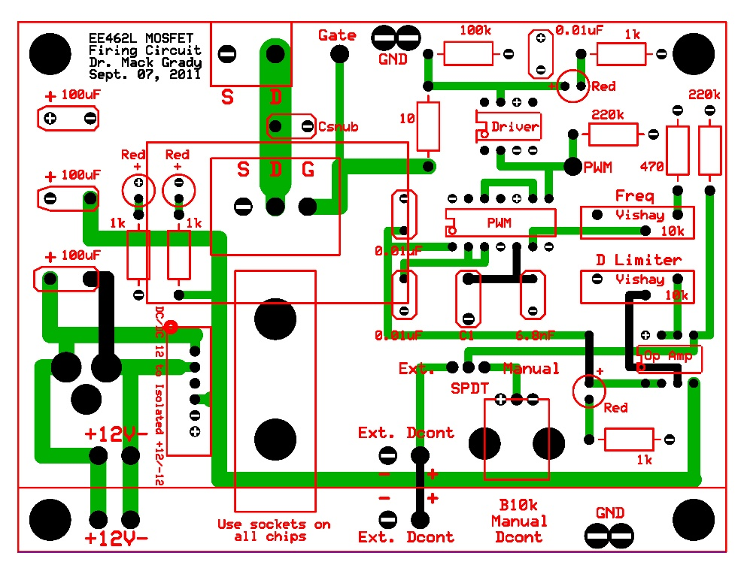
+12V
10
G
D
S
Dual Op Amp
+12V
V_{PWM}
C
+12V
+
LED
100k
Buffer
220k
8, 7, 6, 5
SPDT
Buffer
14, 13, 12, 11, 10, 9, 8
Driver
1k
D_{cont,ext}
−
+
PWM Modulator
MOSFET
−
+
D_{cont}
1, 2, 3, 4, 5 , 6, 7
1, 2, 3, 4
V_{GS}, V_{DS}
220k
B10k
+
LED
C
C
+12V
15 turn
B10k
1k
All caps in this figure are ceramic. Unlabeled C’s are 0.01uF.
D_{cont,limiter}
C1
6.8nF
B10k
D_{cont,man}
470
15 turn
symbol shows direction of resistance change for clockwise turn
CF
Switching frequency control
RF

Slide 9
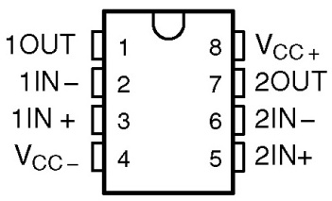
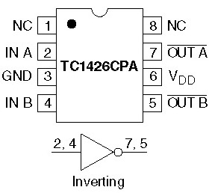
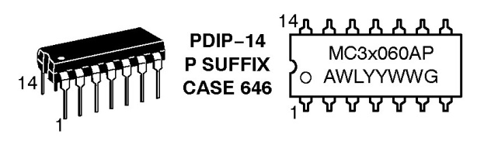
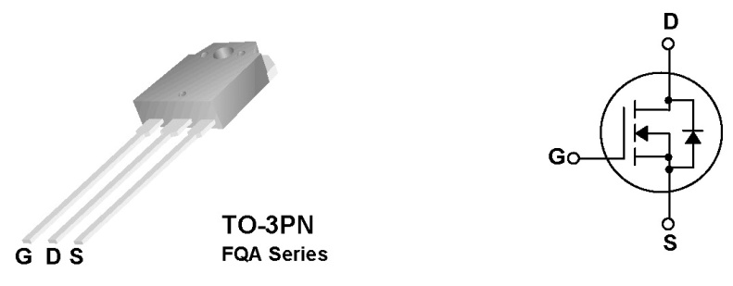
+12V
10
Dual Op Amp
+12V
C
G
D
S
V_{PWM}
+12V
+
LED
100k
Buffer
14, 13, 12, 11, 10, 9, 8
220k
8, 7, 6, 5
1k
D_{cont,ext}
SPDT
−
+
Buffer
PWM Modulator
Driver
MOSFET
−
+
D_{cont}
1, 2, 3, 4, 5 , 6, 7
1, 2, 3, 4
V_{GS}, V_{DS}
220k
B10k
+
LED
C
C
+12V
15 turn
B10k
D_{cont,limiter}
1k
C1
6.8nF
All caps in this figure are ceramic. Unlabeled C’s are 0.01uF.
B10k
D_{cont,man}
470
15 turn
symbol shows direction of resistance change for clockwise turn
CF
Switching frequency control
RF
MC34060A, Fixed Frequency, PWM, Voltage Mode Single Ended Controller
TLE2072CP, Texas Instruments, Dual Low Noise Op Amp
Microchip Technology, TC1426CPA, MOSFET & Power Driver, Inverting, 1.2A Dual
Fairchild FQA62N25C, 250V N-Channel MOSFET, 62A
Gate capacitance ≈ 10 nF

Slide 10





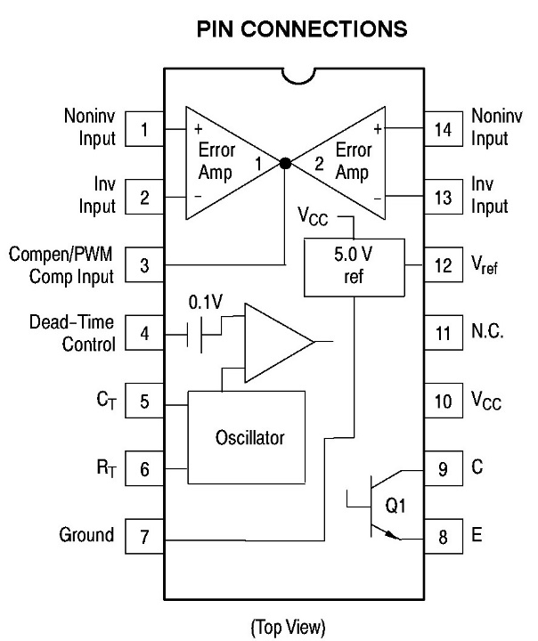
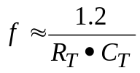
TLE2072CP, Texas Instruments, Dual Low Noise Op Amp
Microchip Technology, TC1426CPA, MOSFET & Power Driver, Inverting, 1.2A Dual
MC34060A, Fixed Frequency, PWM, Voltage Mode Single Ended Controller

Slide 11
The PWM chip has an internal sawtooth wave generator, whose frequency is controlled by an external R and C
Internal sawtooth
3.5V
0-3.5V adjustable analog input (duty cycle control)
Linear portions of sawtooth allows to directly translate voltage levels into time intervals (on-times)
12V
In essence, the PWM process involves comparing a sawtooth (or any other periodic function with linear transitions) with a voltage level. If the voltage level is constant, it will tend to produce a constant (dc) output.
Duty cycle control
PWM signal
+
-
sawtooth

Slide 12
The PWM chip has an internal sawtooth wave generator, whose frequency is controlled by an external R and C
Internal sawtooth
3.5V
0-3.5V adjustable analog input
Output of PWM chip
5V
Comparison yields 0-5V control input to driver chip
Output of inverting driver chip goes to MOSFET gate
12V
So, raising the 0-3.5V analog input raises the duty cycle of the MOSFET 12V gate signal

Slide 13
To control the duty cycle and provide fast turn-on and turn-off, we use
A 0-12V signal from a MOSFET driver chip to very quickly turn the MOSFET on and off at 20kHz-100kHz by charging and discharging the MOSFET gate capacitance (nano Farads)
A pulse-width modulator (PWM) chip to provide a 0-5V control input to the MOSFET driver chip
A 0-3.5V analog voltage to control the duty cycle of the PWM chip

Slide 14
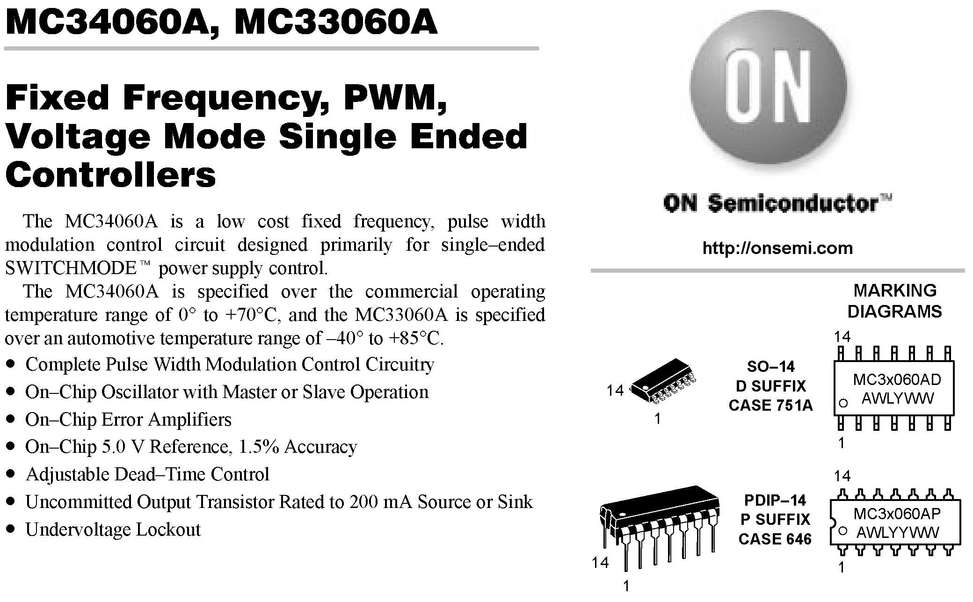

Slide 15
Some PCB Electronics suppliers
Digikey http://www.digikey.com
Mouser http://www.mouser.com/
Arrow http://www.arrow.com/
Allied http://www.alliedelec.com
Newark http://www.newark.com/
(Note: Digikey & Mouser will let one purchase smaller quantities, although it will cost more per component.)
To look up a part number’s spec sheet, go to a supplier’s website, type in the part number, and they should have a link to the actual spec sheet of the part in question.

Slide 16
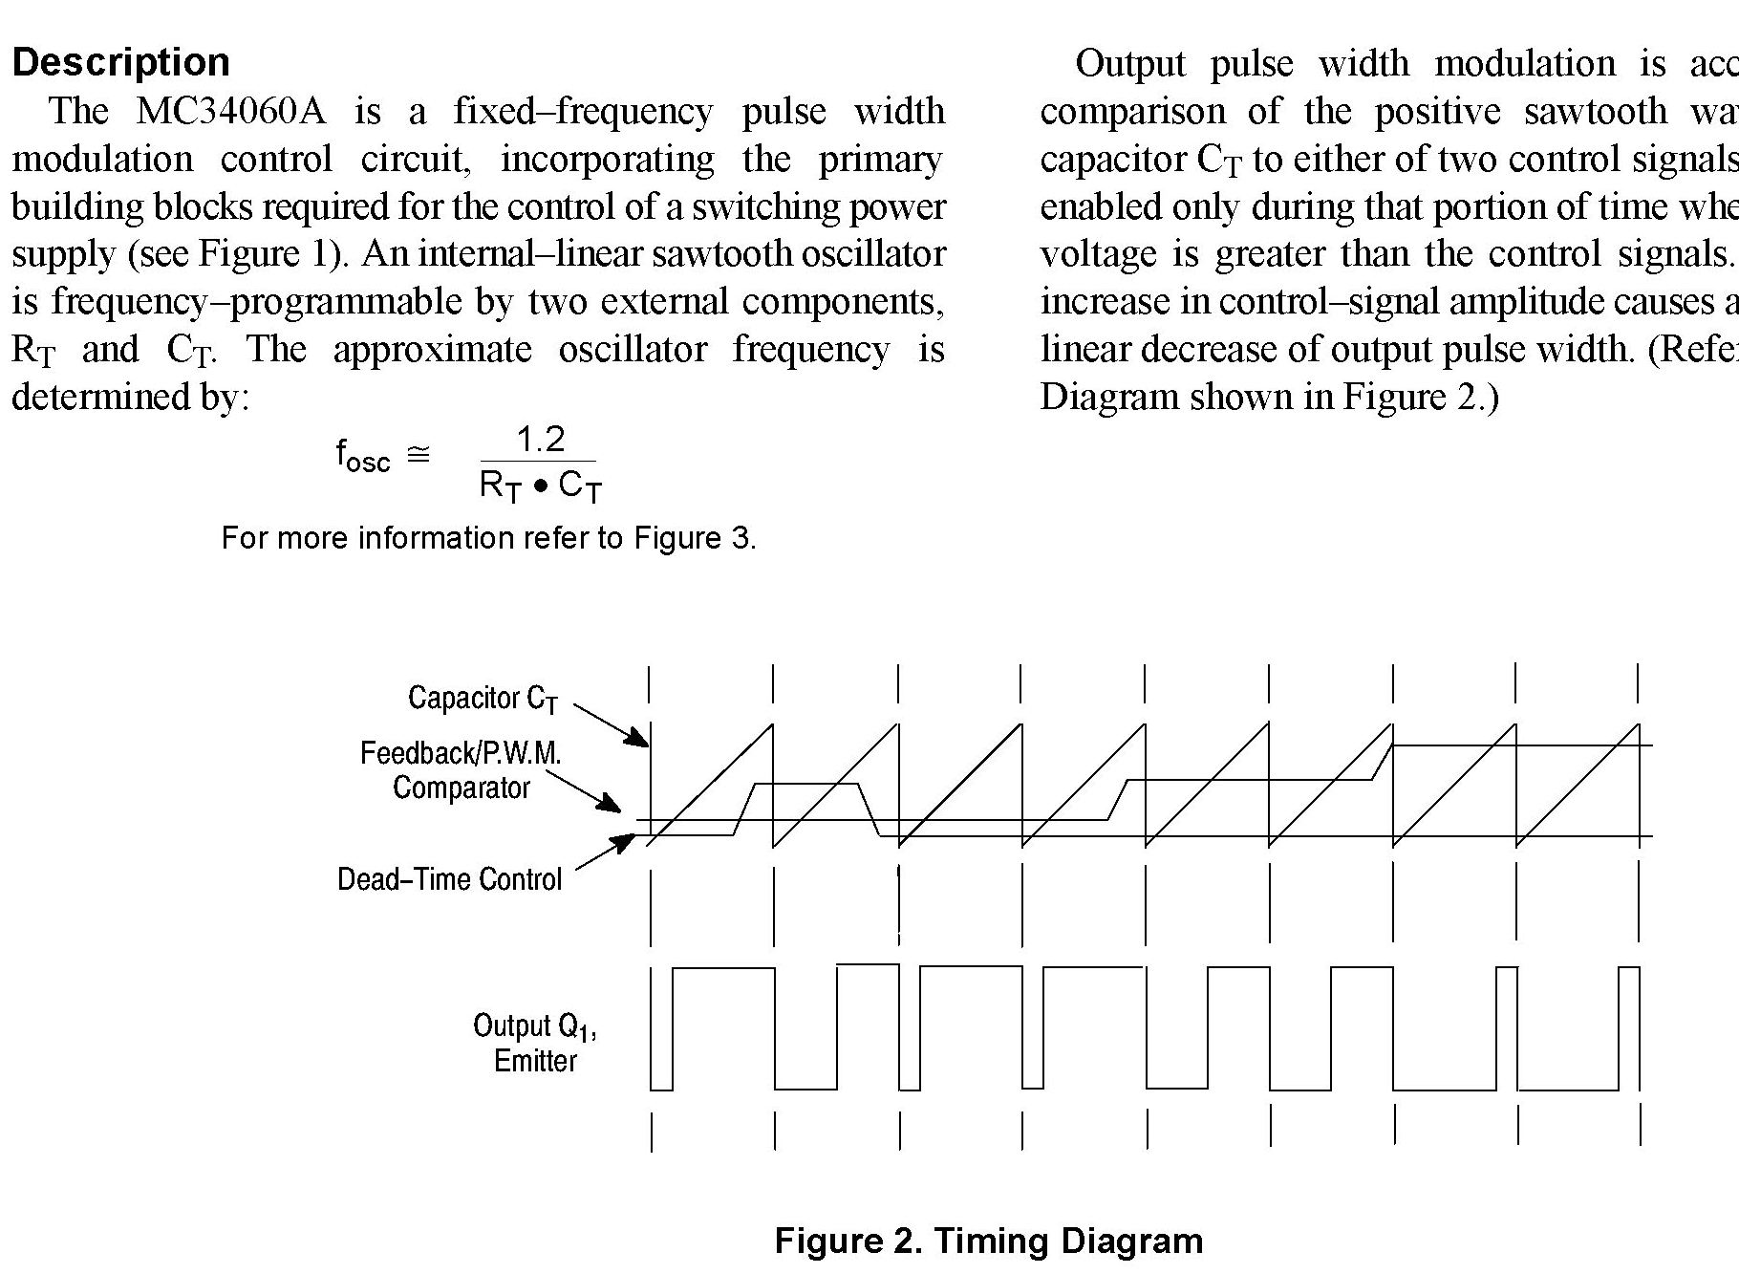
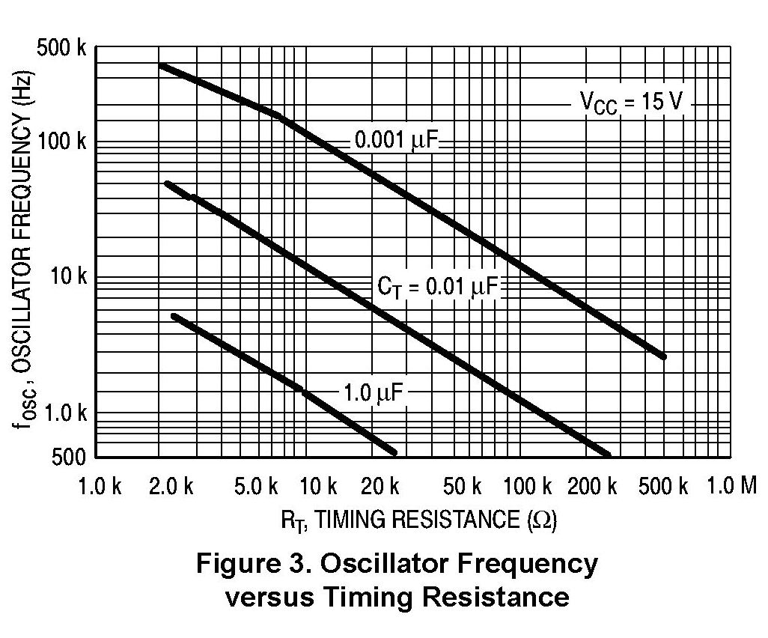
Keep in mind that your C_{T} may be 20% higher than labeled

Slide 17
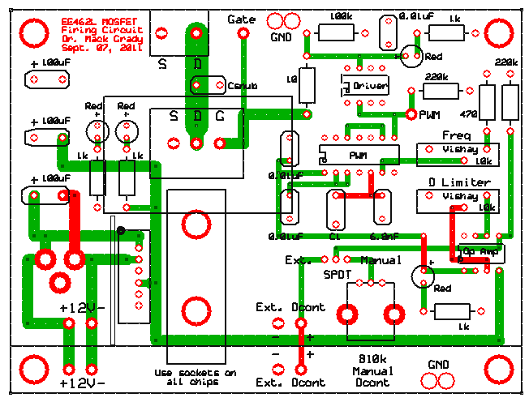

Slide 18
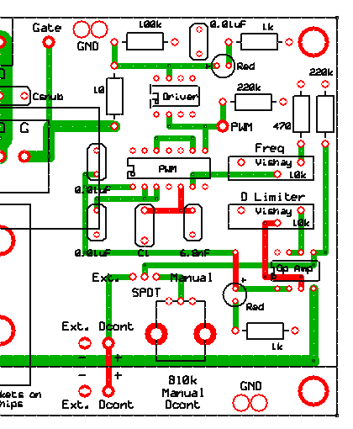
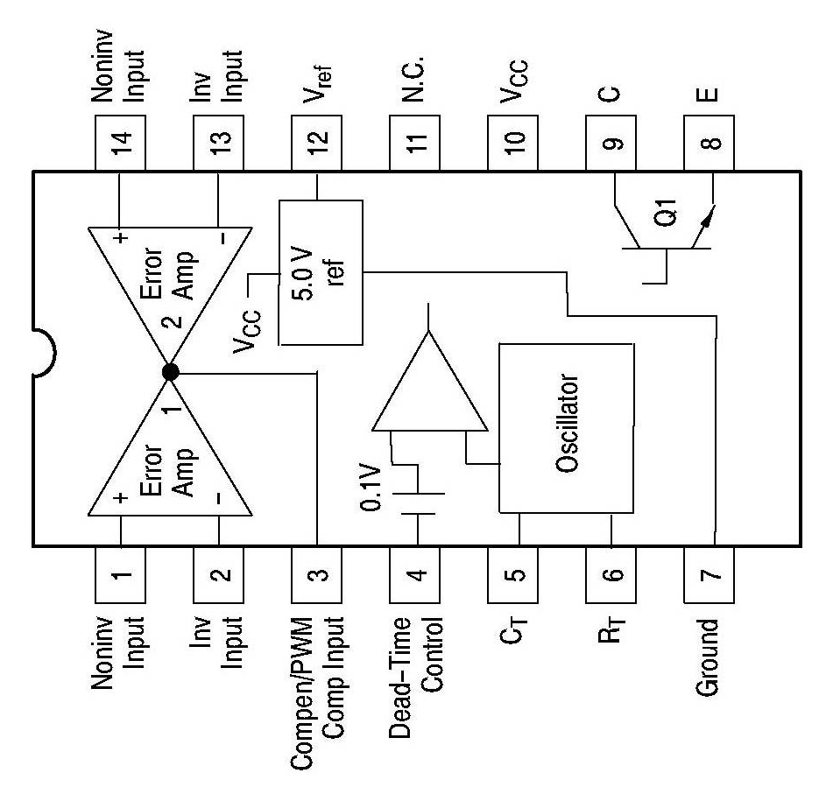

Slide 19
One can see that from Pin 6, R_{T} = 10k potentiometer + 470Ω (in series)
And from Pin 5, C_{T} = two, 6.9 nF capacitors in parallel = 13.8 nF
Since the 470Ω resistor and the C values are fixed,
adjusting the 10k pot will then control f_{OSC}.
R_{T}
C_{T}

Slide 20
What About the Other Potentiometer?
The D Limiter; What’s Its Function?
D Limiter - UCL
Acts as an Upper Bounds to limit the maximum range of D
D Limiter
(UCL)
75%
0%
100%
Restricting the duty cycle’s (D) range will become very important later, for certain DC-DC converters
Restricted Range of “D”

Slide 21
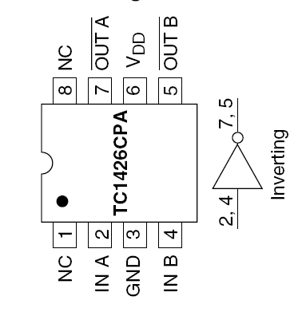
MOSFET Gate Driver – Assures Rapid Turn On and Off

Slide 22
MOSFET Gate Driver – Assures Rapid Turn On and Off
Note:
For mounting your ICs, look for this dot. This dot designates which pin is Pin 1
Aside:
N.C. = No Connect

Slide 23

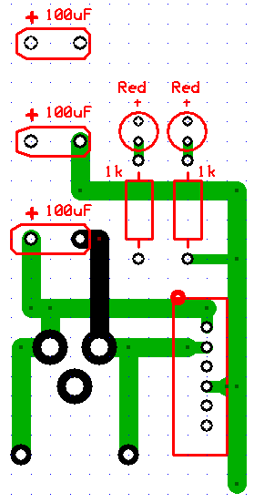
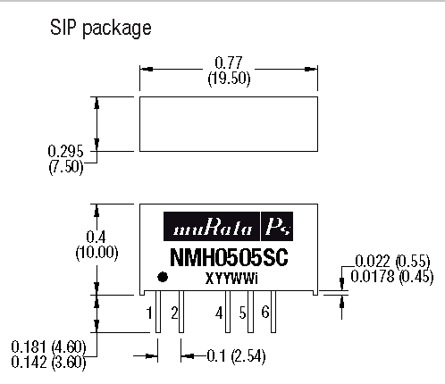
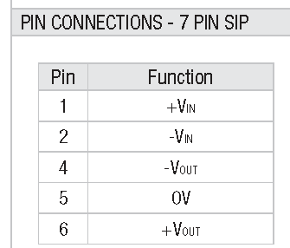
Power Section
100uF, 50V low ESR electrolytics,
1. power plane to ground plane,
–power traces to ground plane,
across wall wart.
NMH1212SC, Murata Power Solutions, DC/DC Converter & Regulator 2W, +12,-12V Dual Output
Converter input
Plug in 12V regulated wall wart (marked with red 12R)
Converter −12V feeds −power traces
Converter 0V to ground plane
Converter +12V to power plane
Wall wart +12V
Wall wart 0V

Slide 24
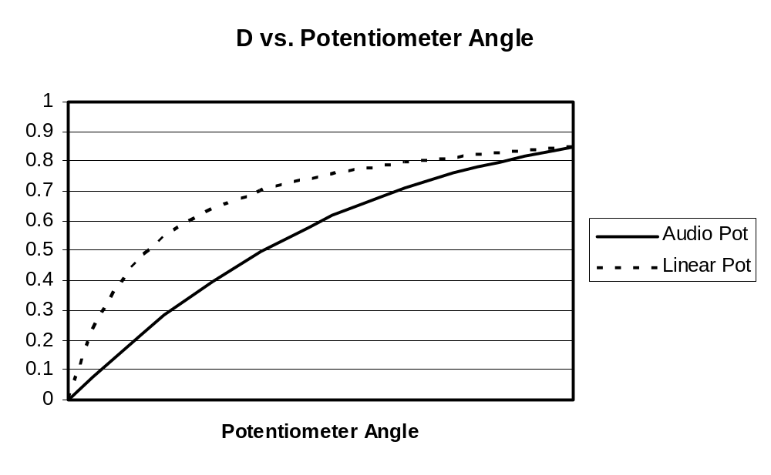
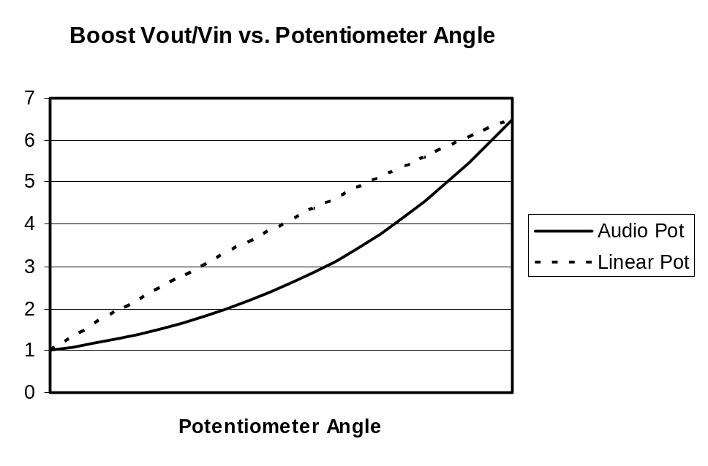
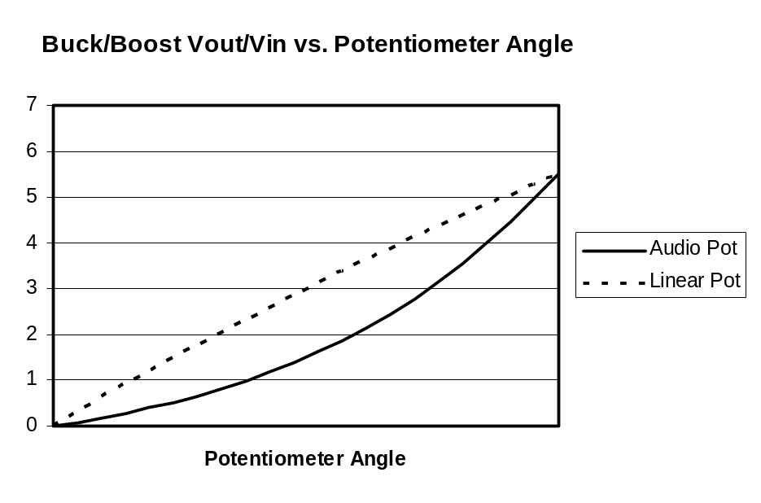
Buck Converter Firing Circuit
Less steep at high voltages

Slide 25
Construction Tips
Use #8 nylon half-inch threaded spacers as feet, with #8 nylon screws on top
All soldering is done on the bottom side of the PCB
Double-socket the chips – one socket stays attached to the chip for re-use each semester. The other socket is soldered to the PCB.
Solder the shortest components first, and the tallest components last
The soldering iron tip should be held firmly on the solder pad, and slightly touching the component
Use wood props to hold components flat on the top surface while you solder the bottom side
Traces are rated 4A per 0.1” of width. The thin ones here are 0.05”, and the wide one is 0.20”.
It is time to memorize the color code. Ask around for a jingle.
B, B, R, O, Y, G, B, V, G, W
0, 1, 2, 3, 4, 5, 6, 7, 8, 9

Slide 26
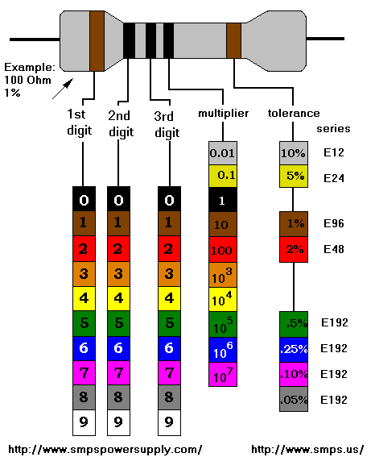
Resistor Color Code

Slide 27
Construction Tips, cont.
  Orient the resistors so the color code reads left to right, or top to bottom
  BEFORE SOLDERING, make sure that the green plugs point in the desired direction
  The long lead on LEDs is +
  Do not solder the MOSFET – it will be screwed to a green plug

Slide 28
MOSFETS are Very Static Sensitive
Touching the gate lead before the MOSFET is properly mounted with a 100kΩ gate-to-source resistor will likely ruin the MOSFET
But it may not fail right away. Instead, the failure may be gradual. Your circuit will work, but not correctly. Performance gradually deteriorates.
When that happens, you can spend unnecessary hours debugging
Key indicators of a failed MOSFET are
Failed or burning hot driver chip
Burning hot gate driver resistor (discolored, or bubbled up)
Board scorches or melts underneath the driver chip or gate driver resistor
Avoid these problems by mounting the MOSFET last, by using an antistatic wristband, and by not touching the gate lead

Slide 29
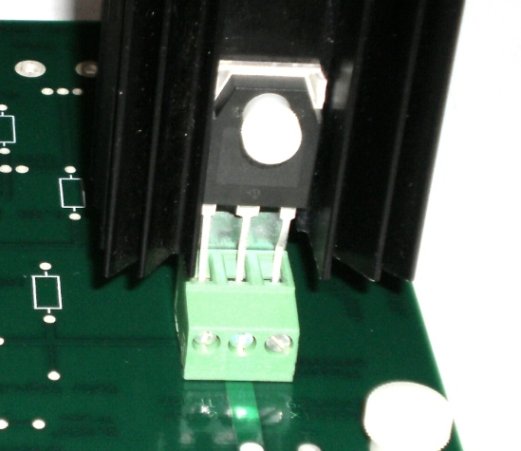
The 100kΩ gate-to-source resistor is soldered onto the PCB.
A 3-pin header strip (under the green plug) is soldered to the PCB, with the black plastic strip of the header on top of the PCB.
Before taking the MOSFET out of the pink zip bag, push the green plug down (hard) onto the header strip.
Then, using an antistatic wristband, and without touching the gate lead, insert the MOSFET into the green plug and tighten the three screws.
After that, mount the heat sink assembly with nylon hardware and tighten the MOSFET firmly to the heat sink.
D: Drain
S: Source
G: Gate

Slide 30
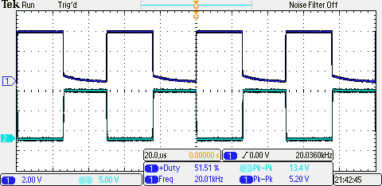
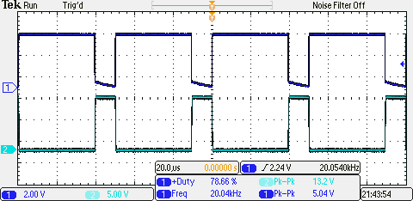
Initial Checkout. Use 20kHz, with MOSFET Mounted,
But No DBR Power to MOSFET
With Dcont fully counter-clockwise, D should be about 0.05
Rotate Dcont fully clockwise, and adjust D limiter until D is about 0.90
Then, capture the waveforms shown below
V_{PWM}
D ≈ 0.5
V_{GS}
V_{PWM}
D ≈ 0.2
V_{GS}

Slide 31
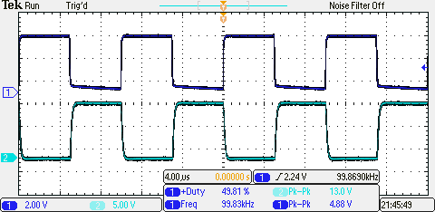
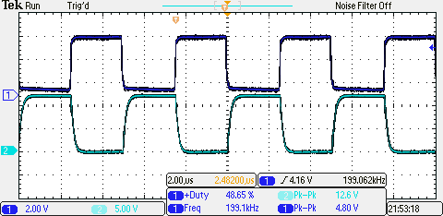
With MOSFET, No DBR Power to MOSFET
V_{PWM}
20kHz
V_{GS}
V_{PWM}
100kHz
V_{GS}
V_{PWM}
200kHz
V_{GS}

Slide 32
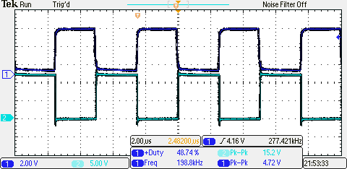
200kHz, No DBR Power to MOSFET
V_{PWM}
With MOSFET
5μsec
V_{GS}
V_{PWM}
Without MOSFET
V_{GS}

Slide 33
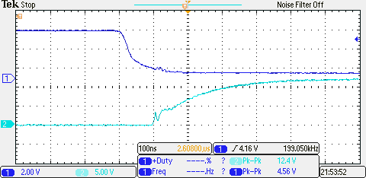
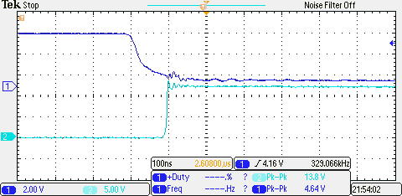
200kHz, No DBR Power to MOSFET
V_{PWM}
With MOSFET
V_{GS}
(1 – e⁻¹) = 0.632, tau ≈ 140nsec = 0.14μsec
Check 10nF • 10Ω = 100nsec = 0.1 μsec
V_{PWM}
Without MOSFET
V_{GS}
Fall times are about the same as rise times

Slide 34
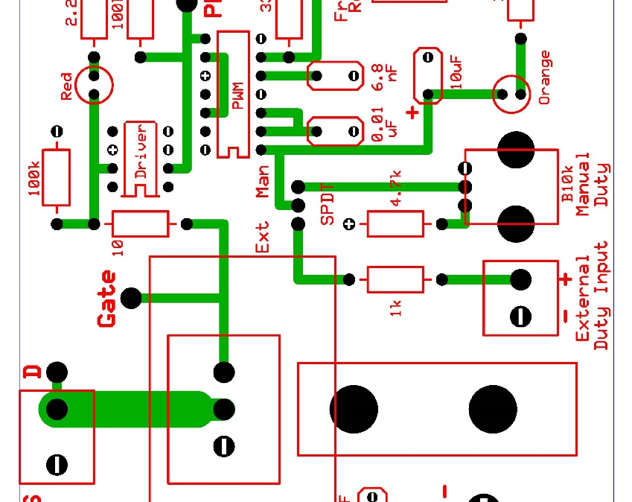
Hard Switching Load Tests (i.e., full interruption of load current with parasitic line inductance). Start with 100kHz.
Before turning on the variac/transformer/DBR, connect scope leads to simultaneously view VGS and VDS.
Set the D control to zero. Raise Vdc (i.e., the DBR voltage) to about 20V.
While viewing VGS and VDS, slowly raise D to about 0.5. Observe and measure the peak value and frequency of the ringing overvoltage in VDS.
Sweep D over the entire range. Does the ringing overvoltage increase with D?
If no sign of trouble, repeat the above with the Vdc about 35 to 40V. Take a screen snapshot of VDS. Measure the peak value and frequency of the ringing overvoltage.
If no sign of trouble, repeat with 200kHz.
DBR
+
−
120/25V Transformer
Variac
10Ω, 100W power resistor
60W light bulb
If peak ringing overvoltage reaches 200V, back off on Vdc

Slide 35
Controlling the Ringing Overvoltage
  Ringing overvoltage is due to the MOSFET capacitance in series with the load circuit’s parasitic inductance (including DBR, wires, and resistor)
  Obviously, in the “hard switching” case, the ringing overvoltage can be greater than the acceptable “twice Vdc.”
  High ringing overvoltage “uses up” the MOSFET’s voltage rating
  To reduce ringing overvoltage, “slow it down” by placing a 0.022 µF ceramic disk capacitor (a.k,a “snubber capacitor”) between the MOSFET’s drain and source terminals.
  Then, repeat the hard switching load test with 35-40 Vdc, D = 0.5, and re-measure the frequency and peak value of the ringing overvoltage.

Slide 36
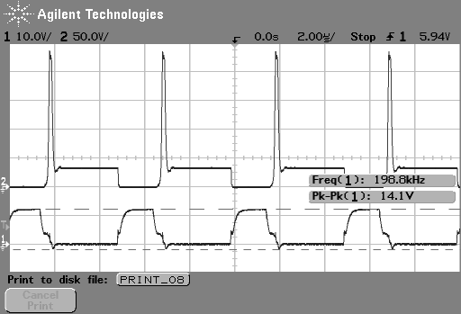
200kHz, MOSFET Switching a 35V, 5Ω Resistive Load
230V
VDS
OFF
35V
ON
VGS

Slide 37
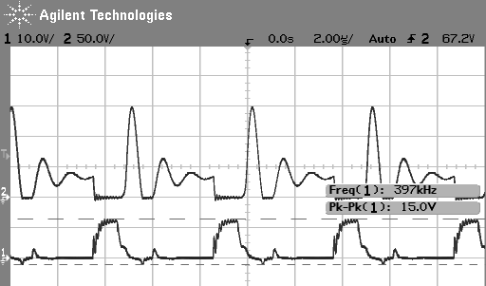
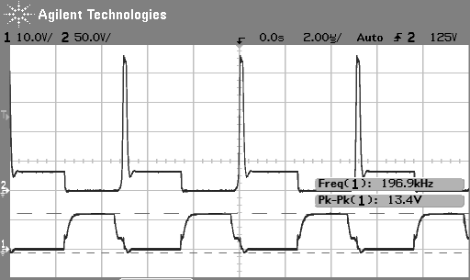
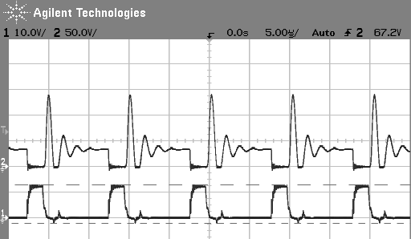
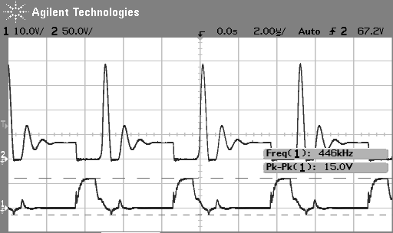
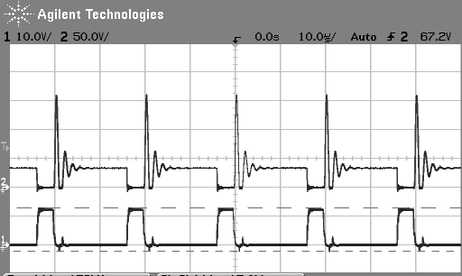
MOSFET Switch Turn-Off Overshoot. MOSFET in series with DBR and (5Ω || with 60W light bulb)
Note – you will use 10Ω. Parallel light bulb optional.
200kHz, 0.01µF snubber
200kHz, no snubber
100kHz, 0.01µF snubber
200kHz, 0.0022µF snubber
50kHz, 0.01µF snubber

Slide 38
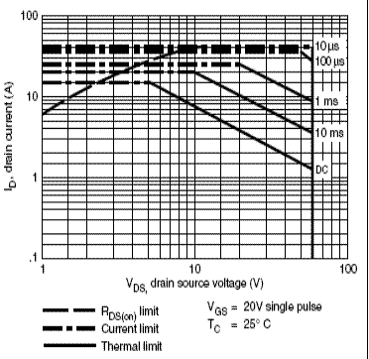
MOSFET Safe Operating Area (SOA)
Maximum continuous drain current can be exceeded but only for a brief time
Pulsed drain current must never be exceed
Thermal limit (power limit) can be exceeded but only for a brief time
Operation naturally limited by R_{DS,on} (Ohm’s law)
Breakdown voltage must never be exceeded

Slide 39
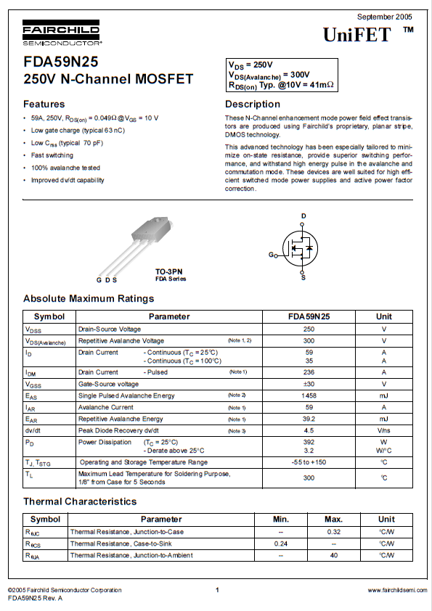
MOSFET Datasheet

Slide 40
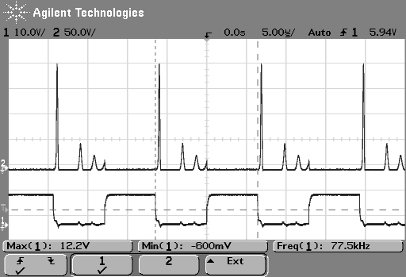
Large 10Ω , 225W Resistor. 5.3Vdc. Vpeak = 200V.
MOSFET opens

Slide 41
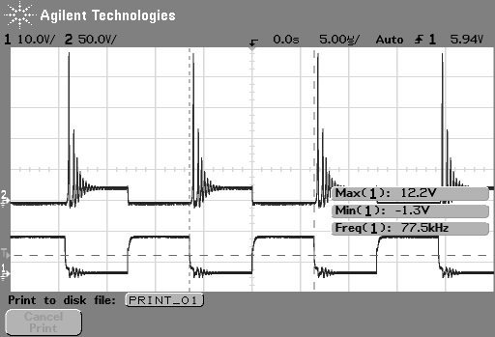
Small 10Ω , 100W Resistor. 22Vdc. Vpeak = 240V.
MOSFET opens
V_{DS}
ON
V_{GS}
OFF
D
Note: Due to ringing, you may have to measure D manually on the O-scope

Slide 42
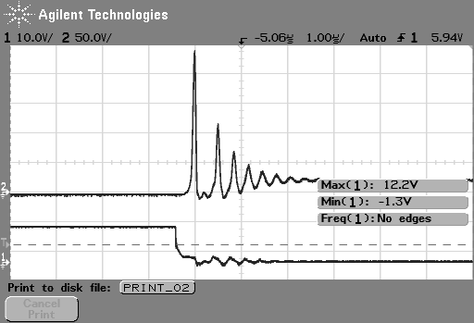
Small 10Ω , 100W Resistor. 20Vdc. Vpeak = 240V.
MOSFET opens
V_{DS}
ON
V_{GS}
OFF
∆t
Measure ∆t to determine ƒ_{ringing} Turn OFF

Slide 43
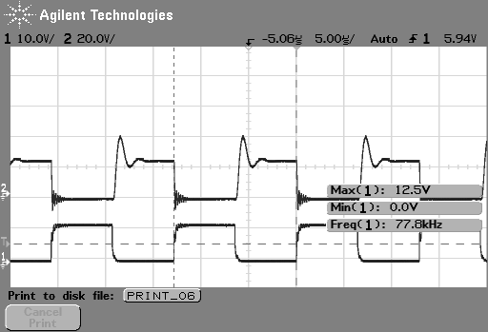
Small 10Ω , 100W Resistor. 22Vdc. Vpeak = 40V.
0.022µF Snubber Cap
MOSFET opens

Slide 44
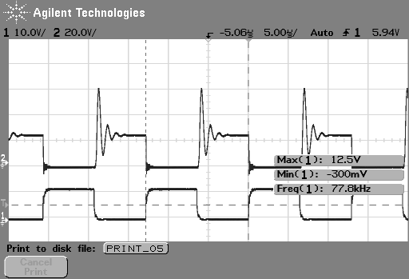
Small 10Ω , 100W Resistor. 22Vdc. Vpeak = 60V
0.0068µF Snubber Cap
MOSFET opens

